Slide 1

Chapter 44 Java 2D

Slide 2
Objectives
To obtain a Graphics2D object for rendering Java 2D shapes (§44.2).
To use geometric models to separate modeling of shapes from rendering (§44.3).
To know the hierarchy of shapes (§44.3).
To model lines, rectangles, ellipses, arcs using Line2D, Rectangle2D, RoundRectangle2D, Ellipse2D, and Arc2D (§44.4).
To perform coordinate transformation using the translate, rotate, and scale methods (§44.5).
To specify the attributes of lines using the BasicStroke class (§44.6).
To define a varying color using GradientPaint and define an image paint using TexturePaint (§44.7).
To model quadratic curves and cubic curves using the QuadCurve2D and CubicCurve2D classes (§44.8).
To model an arbitrary geometric path using Path2D and to define interior points using the WIND_EVEN_ODD and WIND_NON_ZERO rules (§44.9).
To perform constructive area geometry using the Area class (§44.10).

Slide 3
Obtaining a Graphics2D Object
protected void paintComponent(Graphics g) {
super.paintComponent(g);
// Get a Graphics2D object
Graphics2D g2d = (Graphics2D)g;
// Use the method in Graphics2D to draw graphics
...
}

Slide 4
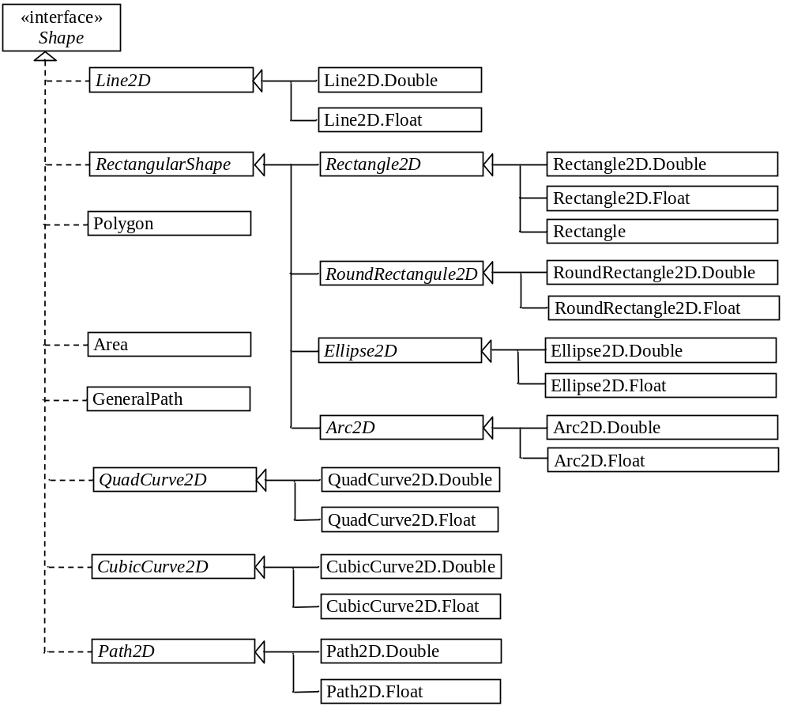
Geometric Models

Slide 5
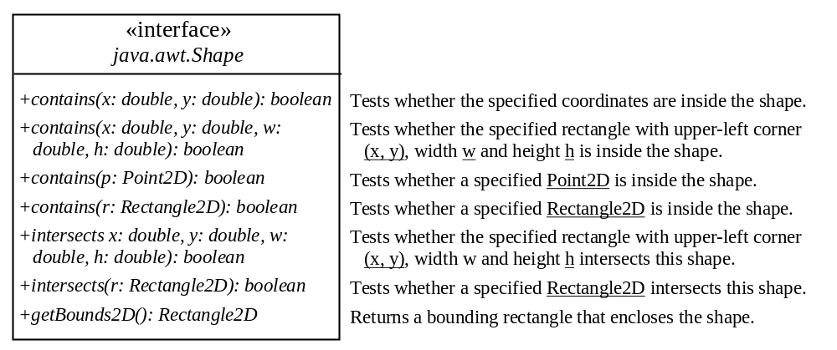
The Shape Interface

Slide 6
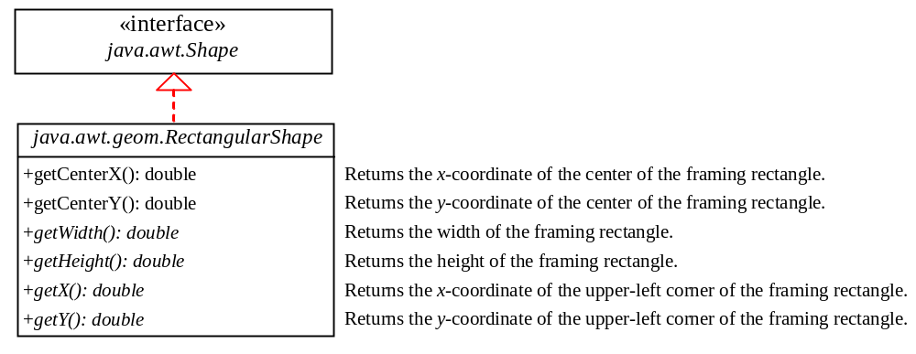
Rectangle2D, RoundRectangle2D, Arc2D, and Ellipse2D
Graphics2DDemo
Run

Slide 7
Coordinate Transformations
Java 2D provides the classes for modeling geometric objects. It also supports coordinate transformations using translation, rotation, and scaling.

Slide 8
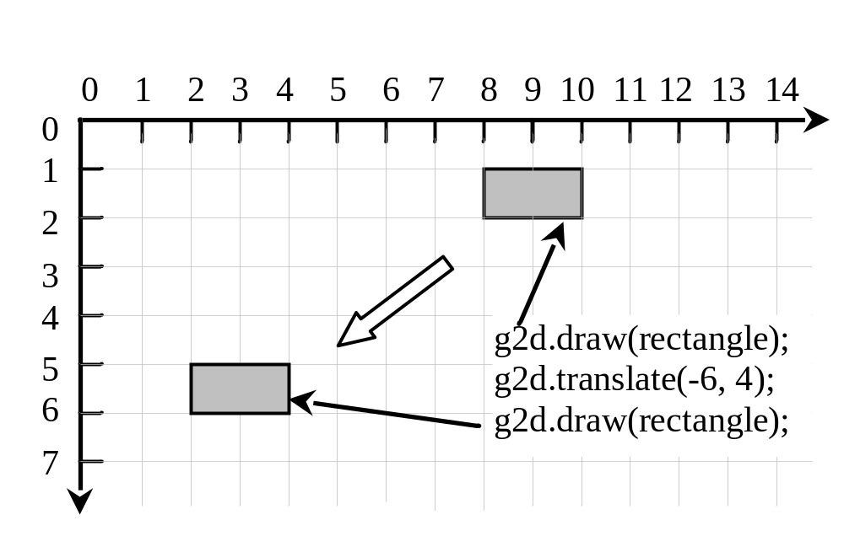
Translations
TranslationDemo
Run

Slide 9
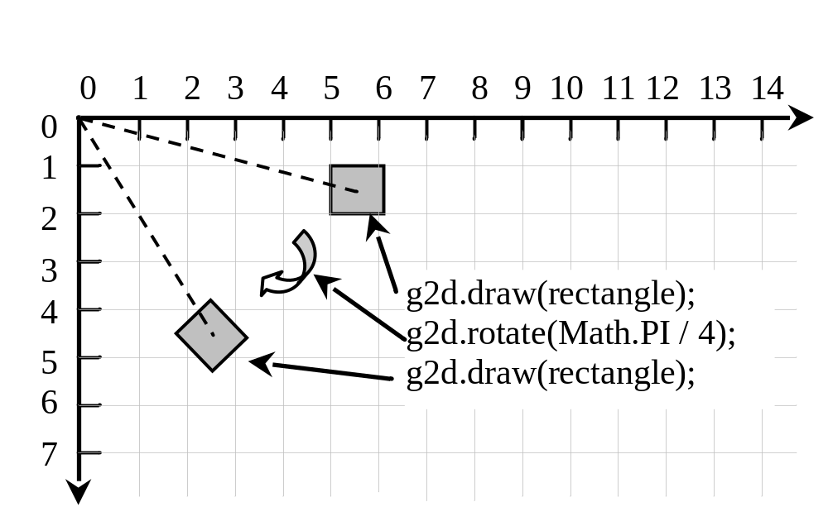
Rotations
RotationDemo
Run

Slide 10
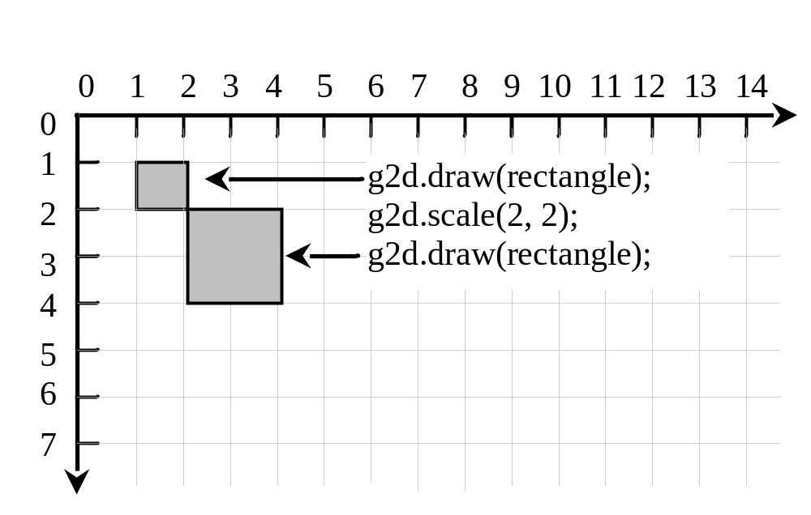
Scaling
ScalingDemo
Run

Slide 11
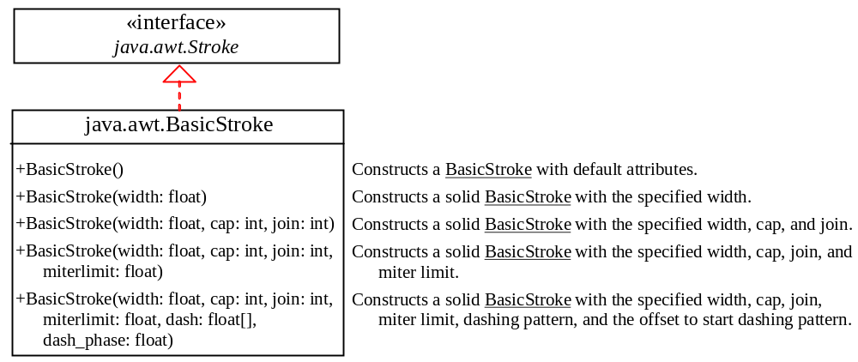
Strokes
BasicStrokeDemo
Run

Slide 12
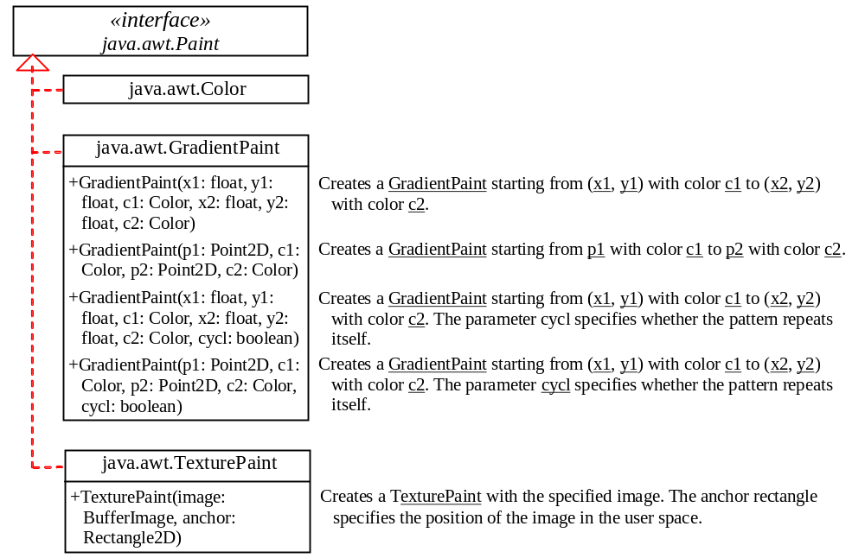
Paint
PaintDemo
Run

Slide 13
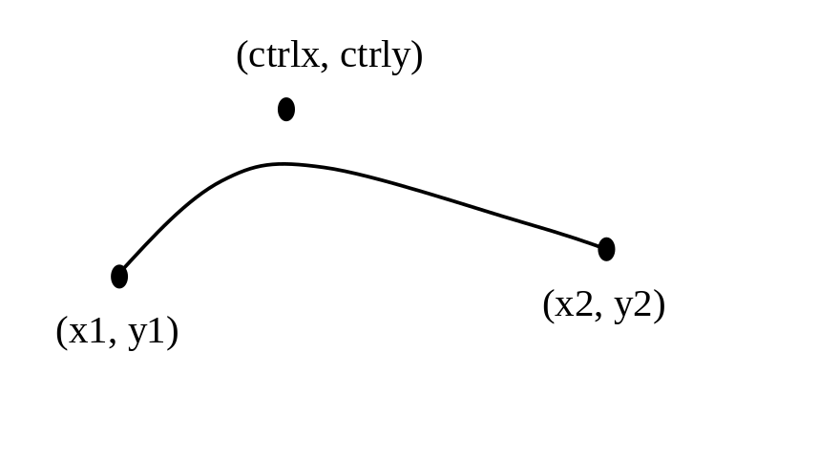
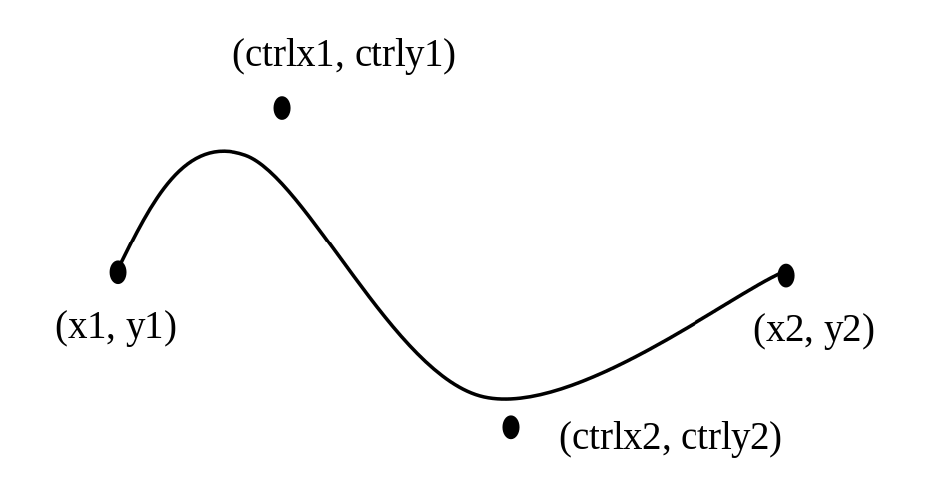
QuadCurve2D and CubicCurve2D
CurveDemo
Run

Slide 14
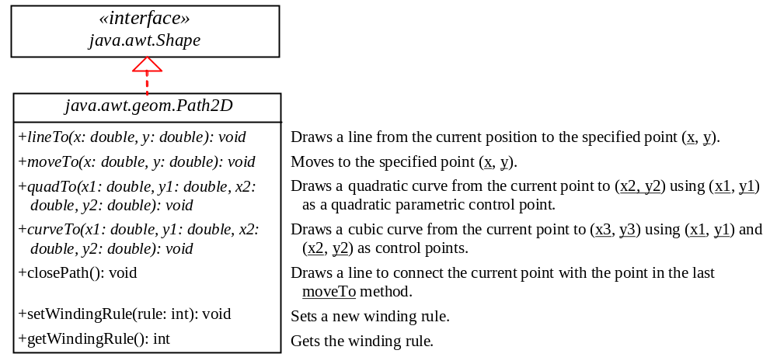
Path2D
Path2DDemo
Run

Slide 15
Winding Rules
The WIND_EVEN_ODD rule defines a point as inside a path if a ray from the point towards infinity in an arbitrary direction intersects the path an odd number of times.
With the WIND_NON_ZERO rule, the direction of the path is taken into consideration. A point is inside a path if a ray from the point towards infinity in an arbitrary direction intersects the path an unequal number of opposite directions.
WindingRuleDemo
Run

Slide 16
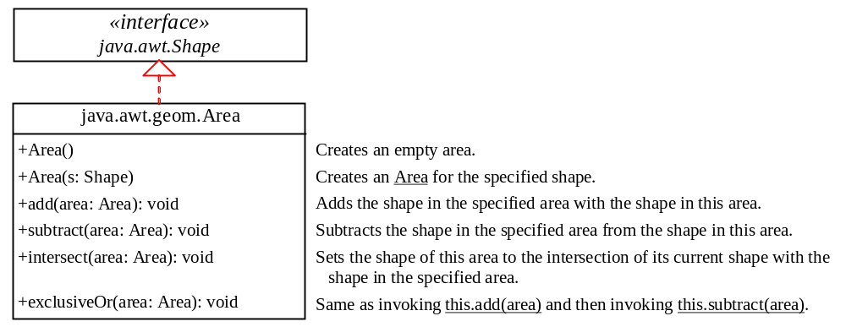
Constructive Area Geometry
AreaDemo
Run

